Slide 1
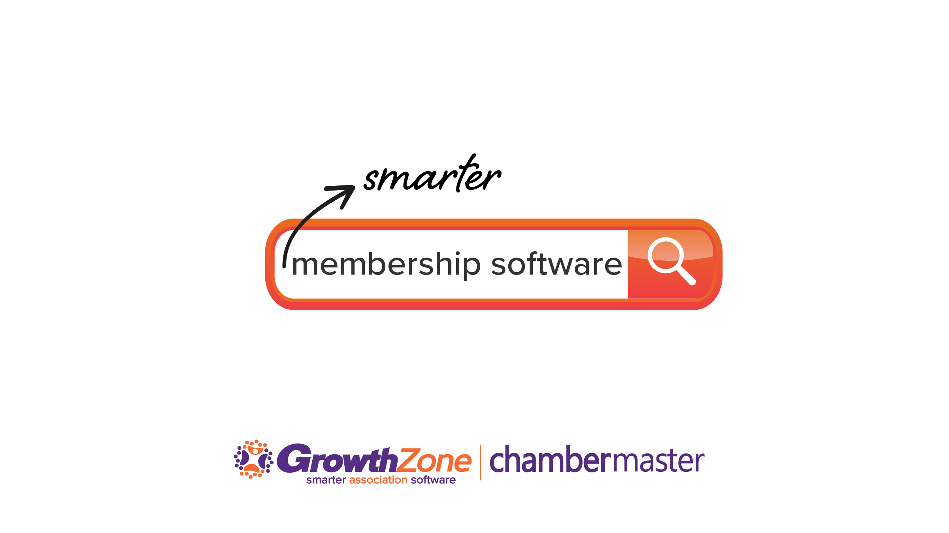

Slide 2
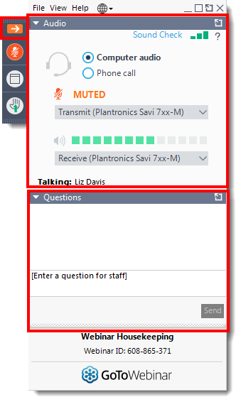
Raise Hand
Audio
Questions

Slide 3

If you have audio issues:
Double check your settings in the Audio Pane
Toggle once between the Telephone and the Mic and Speakers options
Check if you have headphones/speakers plugged in
Check your computer or device volume
Check headphone volume
Check your computer’s Sound settings.
Close other internet tabs
Move your phone away from your computer
Log out and log back in.
Hang up and call back in.
We will send you the recording.

Slide 4
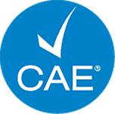
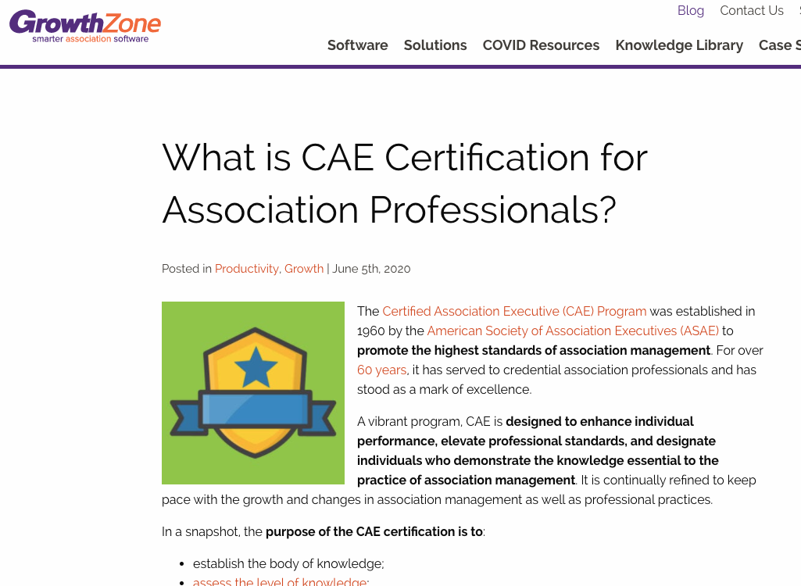
PARTICIPANTS ATTENDING THE LIVE SESSION
WILL RECEIVE 1 CAE CREDIT
Certificates will be emailed to attendees within 1-2 days
.
growthzone.com/blog

Slide 5
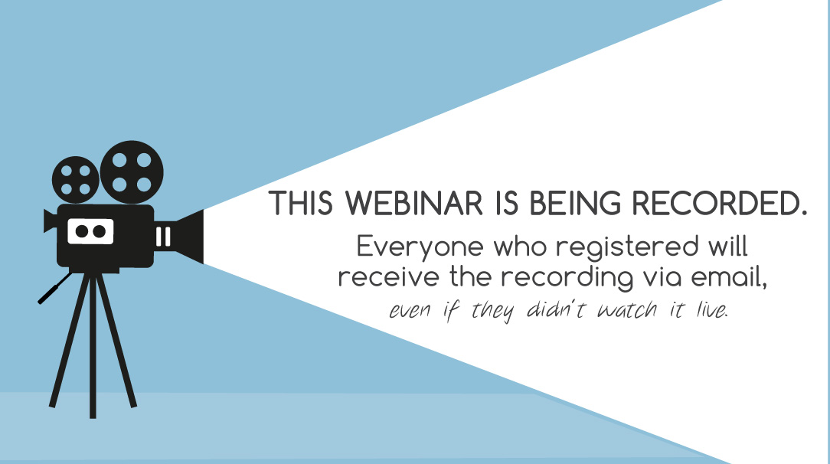

Slide 6

https://cutt.ly/GrowthZoneDemo

Slide 7
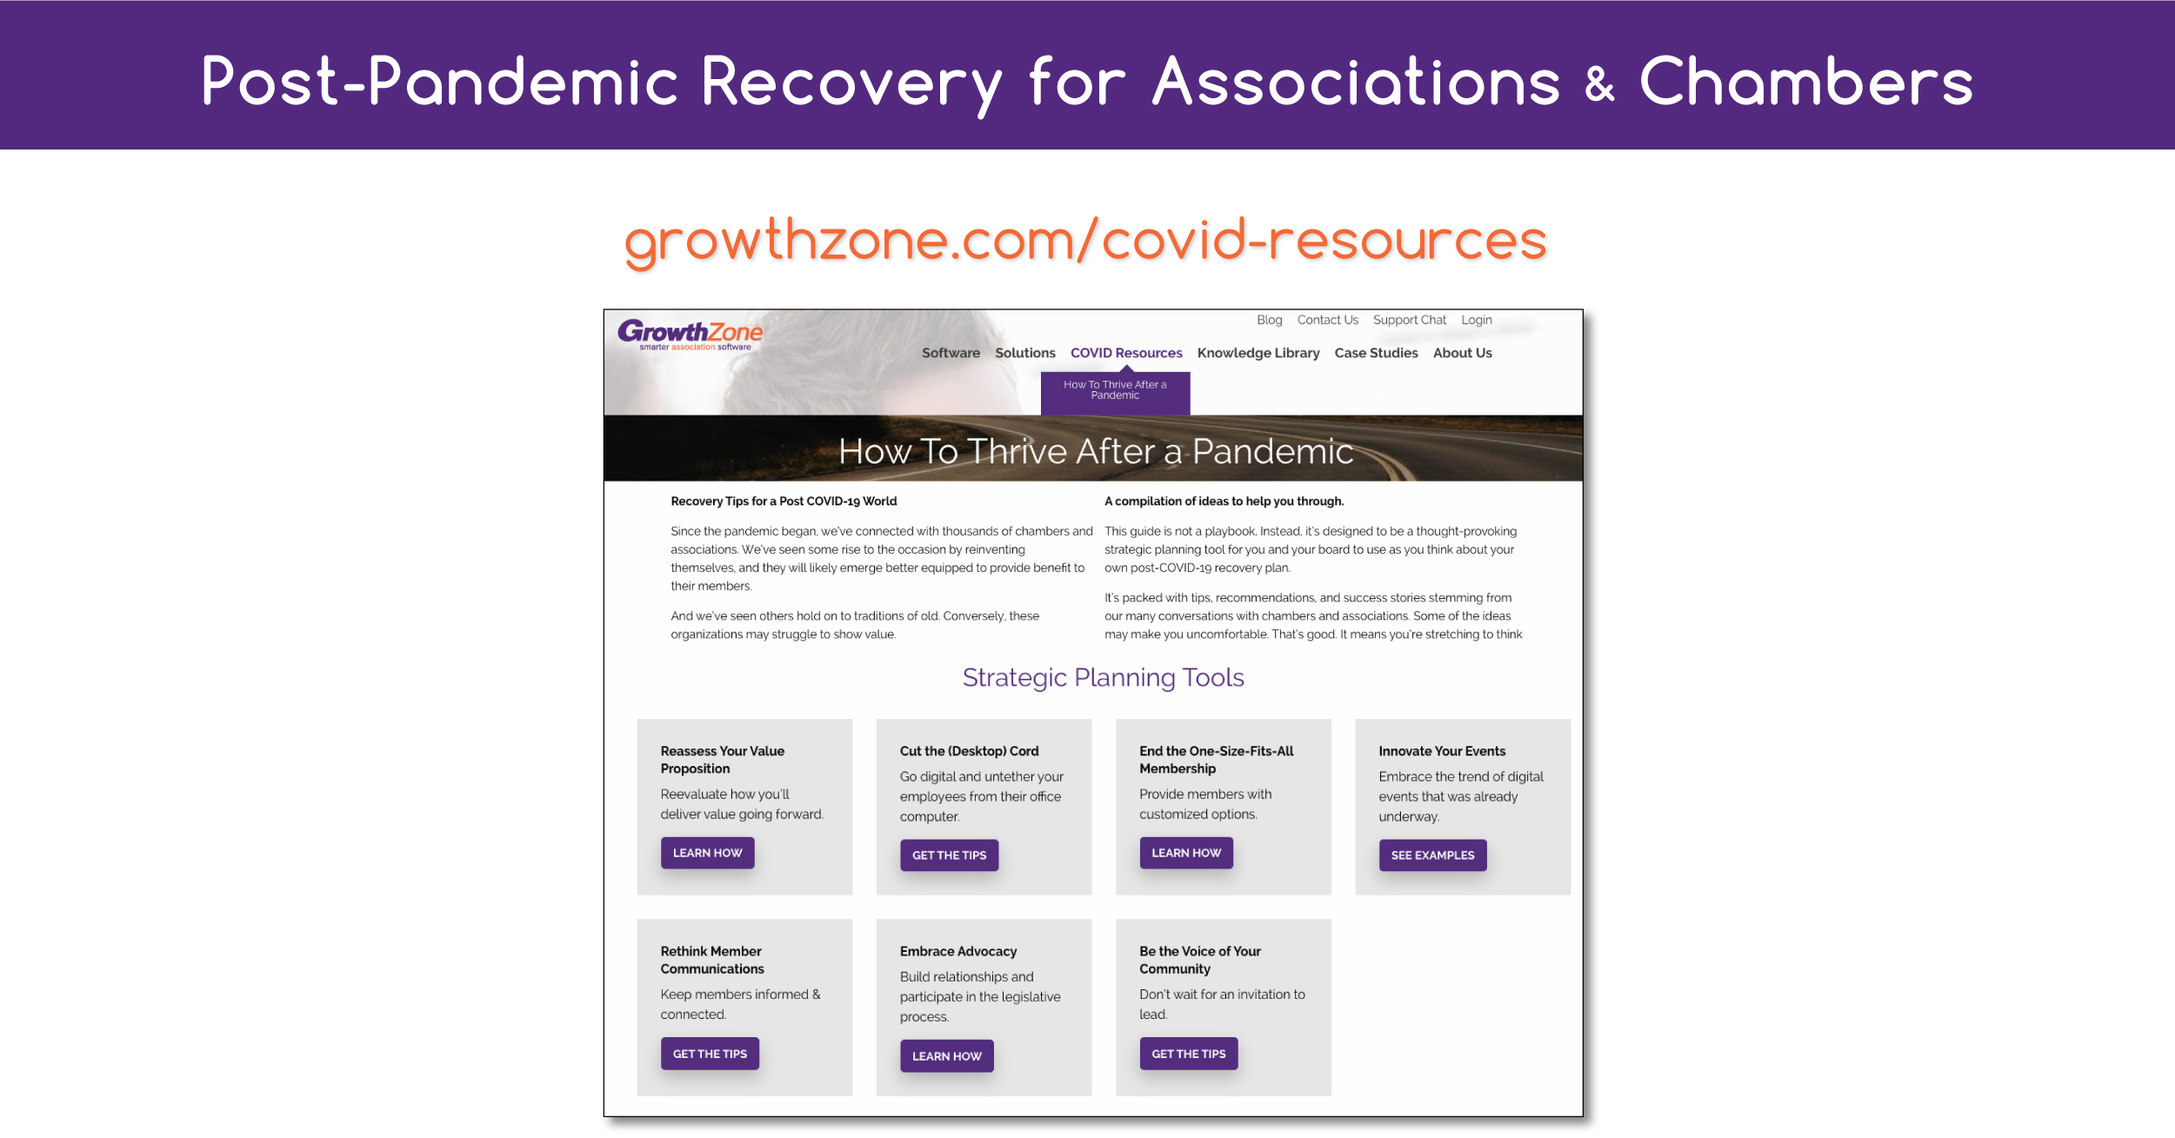

Slide 8
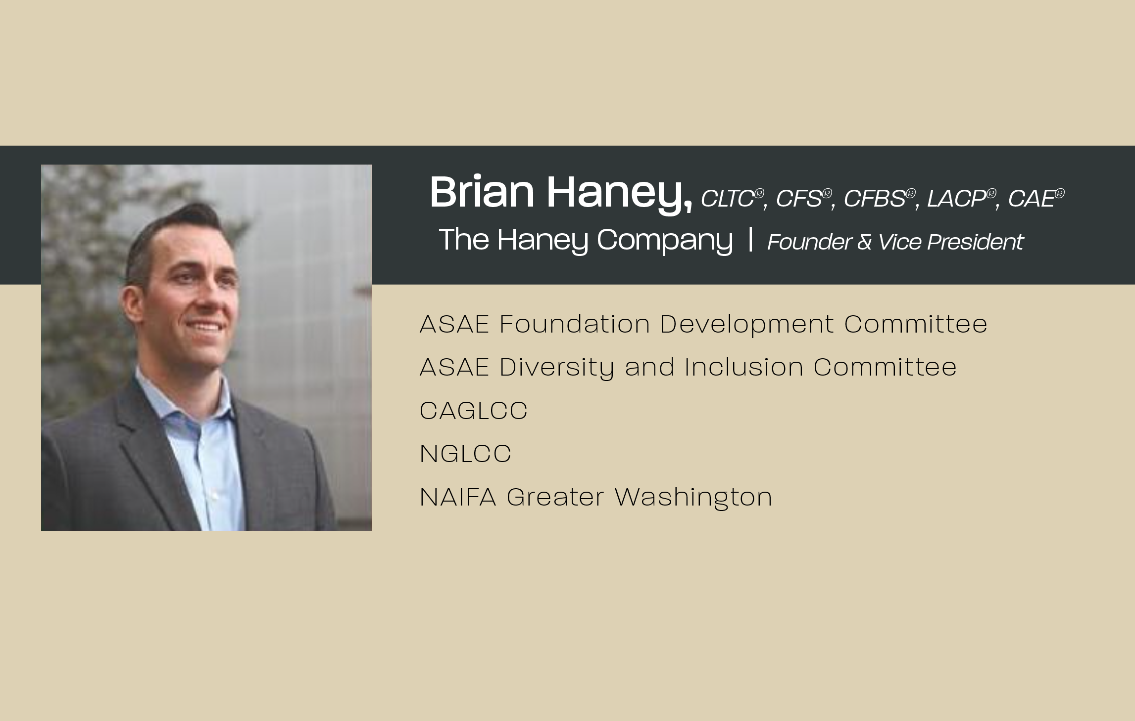

Slide 9


Slide 10
COVID-19 Cyber Security Risks for Remote Association Employees
Presented by: Brian Haney, CAE
Founder & Vice president of the haney company

Slide 11
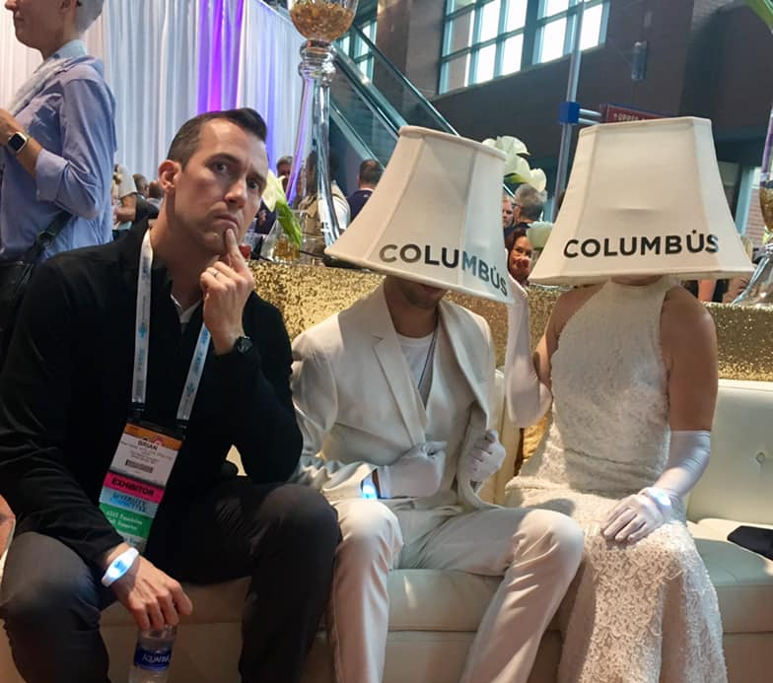
What do you want me to cover?

Slide 12
Here’s what I want to cover
What has happened as a result of COVID19?
What should an Association do?
What should an individual do?
What role does insurance play?
Measure your cyber preparedness
Create a plan to address cyber risk

Slide 13
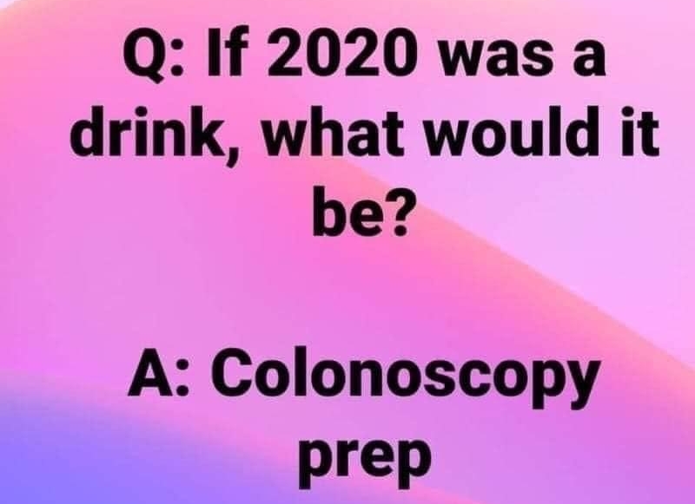

2020 – so far, it’s been a bit of a mess!

Slide 14
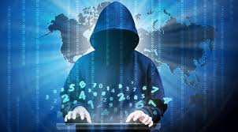
The massive increase in telework = rise in cyber crime
As of April 21, 2020, the FBI's Internet Crime Complaint Center (IC3) has reviewed more than 3,600 complaints related to COVID-19 scams

Slide 15
Covid19 scams are everywhere
  The DOJ & FBI Cyber crime division has disrupted many activities:
  An illicit website pretending to solicit and collect donations to the American Red Cross for COVID-19 relief efforts.
  Fraudulent websites spoofing government programs & organizations to trick Americans into entering personally identifiable information
  Websites of legitimate companies and services that were used to facilitate the distribution or control of malicious software.

Slide 16
Organizations are being hit
  According to a June LIMRA Study over the last 60 days:
  42% of companies have seen an increase in fraudulent activity
  47% have seen an increase in account takeover (ATO) attacks

Slide 17
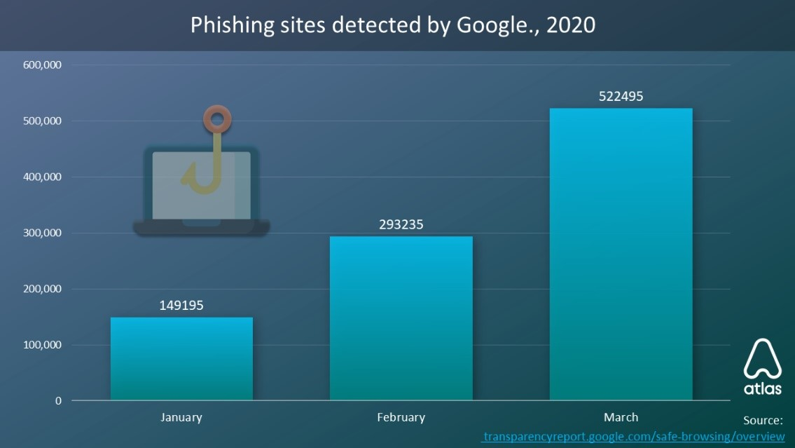
Individuals are being hit also

Slide 18
Common cyber crime examples
  Hacking
  Phishing
  Viruses, worms, malware
  Ransomware
  Financial fraud
  Denial of service attacks (DOS)

Slide 19
What should associations do?
Review and communicate cyber/data protocols
Test system preparedness
Brace for disruption
Defend against the phishing wave
Be extremely careful when using zoom or other video/screensharing programs

Slide 20
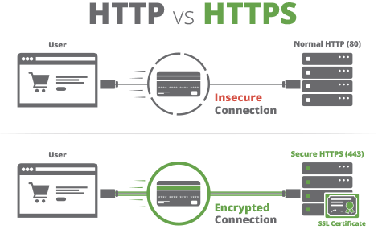
How secure is this website really?

Slide 21
Training is the key to fighting fraud
Make sure all employees are fully aware of the Association’s protocols and guidelines
Provide employees with appropriate courses to enhance their cyber-security knowledge
Advise employees against accessing sensitive data via unsecure networks or on personal devices

Slide 22
Add value to your members
The heightened fraud risk represents a way for Associations to protect members and add value:
Consider making available fraud prevention educational materials to customers/members.
Since many account compromises begin with the customer’s personal computer, email or other accounts, having fraud-aware members can be the best protection

Slide 23
What should employees do?
Use only trusted networks
Consider adopting a password manager
Use double channels of communication with counterparts before transmitting sensitive information
Always check websites before clicking on links

Slide 24
What should individuals do?
Know where you are vulnerable!
Wi-fi
iPhone/iPad personal device
Laptop
Kids and young adults
Elderly

Slide 25
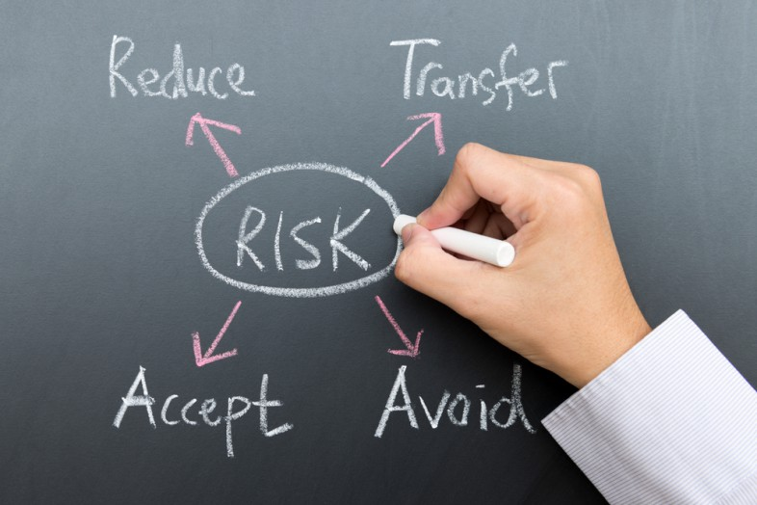
Where does insurance come in?

Slide 26
Common things cyber policies cover (first party):
Loss or damage to digital assets such as data or software programs
Business interruption from network downtime
Cyber Extortion where third parties threaten to damage or release data if money is not paid to them
Customer notification expenses when there is a legal or regulatory requirement to notify them of a security or privacy breach
Reputational damage arising from a breach of data that results in loss of intellectual property or customers
Theft of money or digital assets through theft of equipment or electronic theft

Slide 27
Common things cyber policies cover (third party):
Security and privacy breaches, and the investigation, defense costs and civil damages associated with them
Multi-media liability, to cover investigation, defense costs and civil damages arising from defamation, breach of privacy or negligence in publication in electronic or print media
Loss of third-party data, including payment of compensation to customers for denial of access, and failure of software or systems

Slide 28
Insurance is a partnership
#1 cause of all breaches is human error
Having a policy doesn’t prevent an attack
Having a policy doesn’t absolve you from responsibility
In the event of a breach, two common reasons for the claim being denied:
  Insufficient IT Security
  In the case of wire transfers, a second method of verification not used
Having a policy can protect you financially

Slide 29
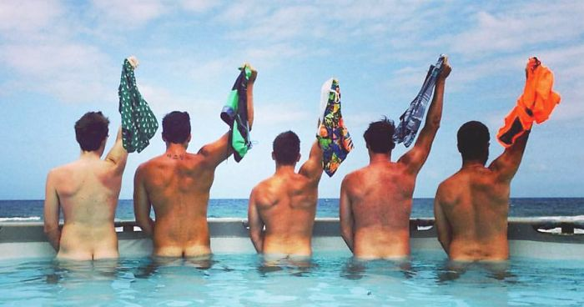
“Only when the tide goes out do you discover who’s been swimming naked.” – Warren Buffett

Slide 30

Let’s measure your cyber preparedness!

Slide 31
Questions for associations
What information security & privacy policies and controls do you have in place already?
Do you require employees to follow written computer and information systems policies and procedures?
Do you have firewall protection? Antivirus protection?
Do you terminate all computer access & user accounts as part of the regular exit process when an employee leaves or when a third-party contractor no longer provides the contracted services?

Slide 32
Questions for associations
Do you have and enforce policies about internal and external data encryption?
Are your employees’ personal devices and laptops secured? What data is stored on those devices and is it encrypted?
What do you utilize for backing up your data?
Do you have a process to review all content prior to posting on online?
Do you screen your content for trademarks or service marks?

Slide 33
Questions for individuals
Do you use complex passwords and change them frequently?
Do you protect your own personal data? Encrypted?
Do you backup your devices regularly (or automatically)?
Are you mindful of open network wi-fi areas?
Do you limit the data you store on personal devices?

Slide 34
Where do you go from here?
Audit yourself if you have not already done so
Address operational risks
Examine business continuity plan
Train and empower employees
Routinely monitor yourself & re-evaluate when needed

Slide 35
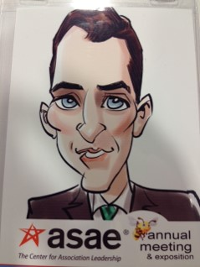
Thanks for your time today
Contact us at: www.thehaneycompany.com
Phone: 301-593-0600
Email: bhaney@thehaneycompany.com
Twitter: @thehaneycompany

Slide 36
Disclaimer
Brian Haney is a Registered Representative of Coastal Equities, Inc. and an Investment Advisory Representative of Coastal Investment Advisors, Inc. Investment Advisory Services are offered through Coastal Investment Advisors, Inc., and securities are offered through Coastal Equities, Inc., Member FINRA/SIPC, 1201 N. Orange St., Suite 729, Wilmington, DE 19801.

Slide 37


